Slide 1
Rise of the Nodebots
Presented By
JOEL LORD
ConUHacks
January 21st, 2017

Slide 2


About me
Joel Lord
Javascript Junkie
Technology enthusiast
Tinkerer

Slide 3
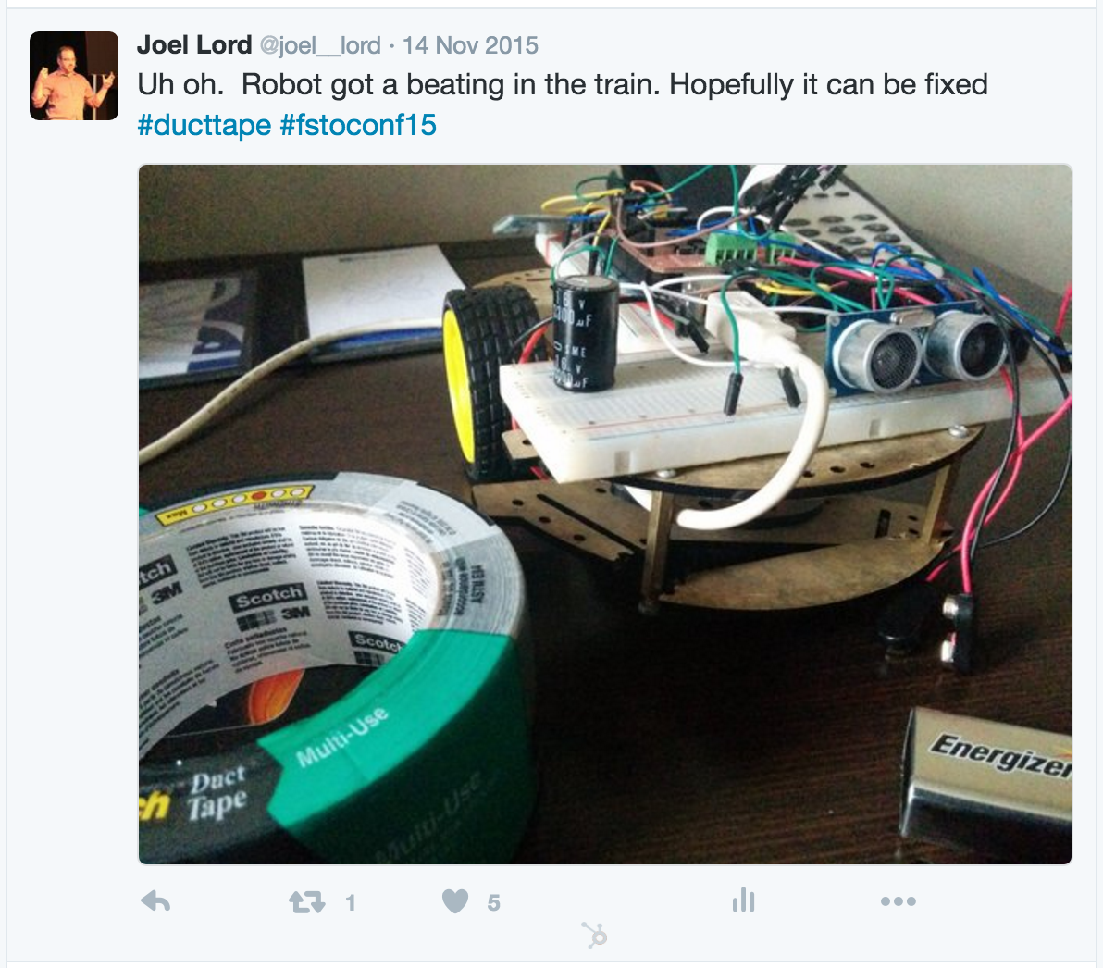
What about your friend there?
My nodebot

Slide 4
Agenda
Demo
Hardware
Software
Setting up the Arduino board
Setting up the project
Building a Hello World!
Building the Night light

Slide 5
Demo Time!
CROSS YOUR FINGERS
Notes:
Demo of something that can be done with J5
Demo of the final product

Slide 6
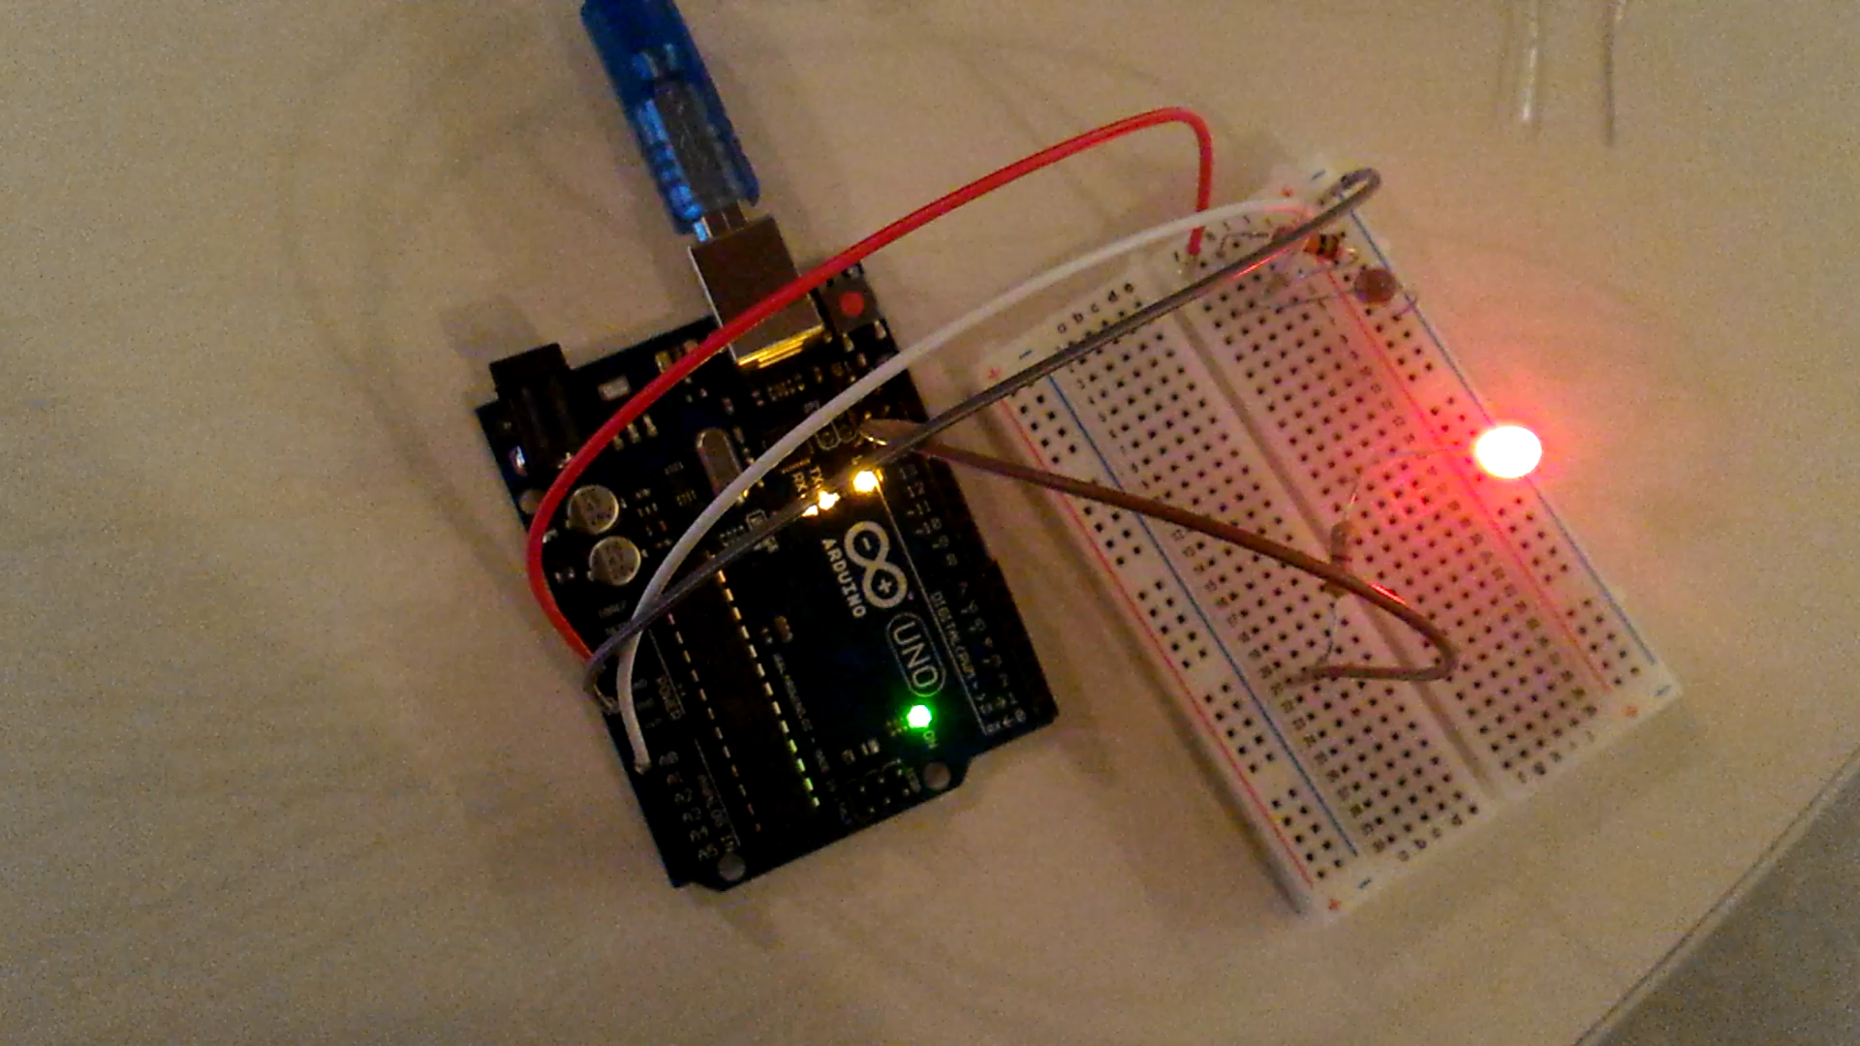
Demo
A Simple and cumbersome night light

Slide 7
Your Kit
CHECK YOUR PARTS

Slide 8
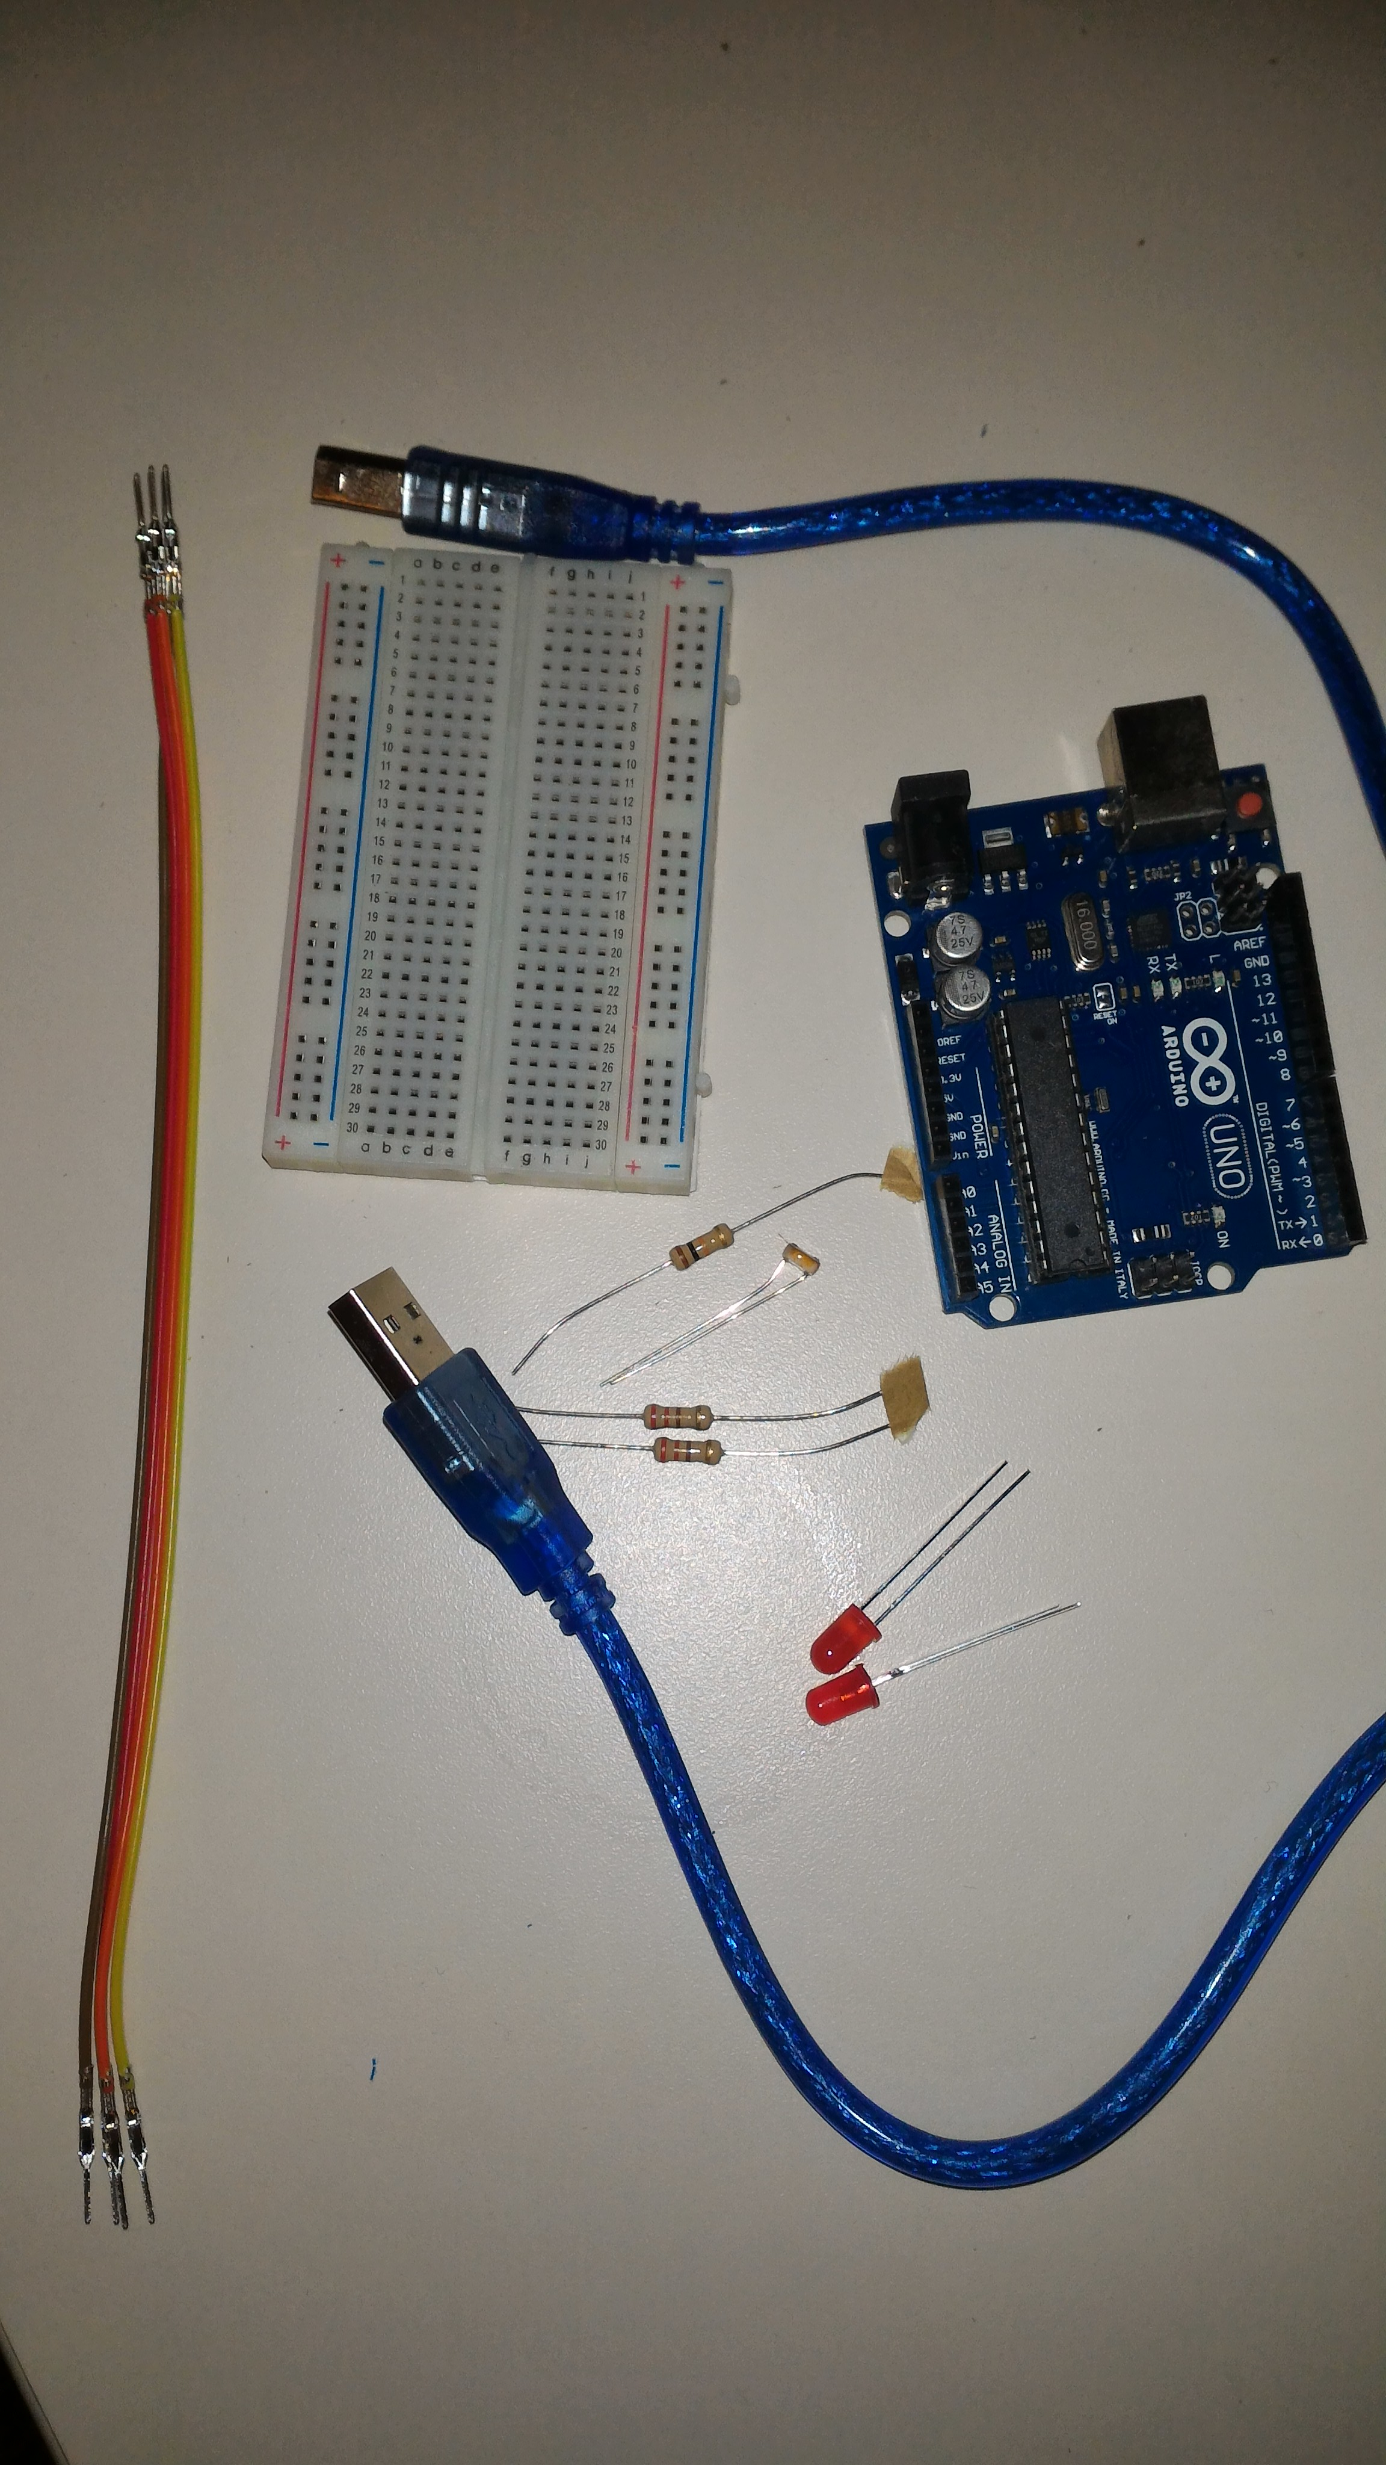
Your Kit
LIST OF COMPONENTS
1 Arduino board
1 USB Cable
1 Breadboard
4 Jumper Cables
2 Red LEDs
2 220 ohms Resistors
1 Photoresistor
1 1k ohms Resistor

Slide 9
Hardware
COVERING THE BASICS

Slide 10

Hardware
Arduino
Open Source hardware and software
Uses an ATMega programmable chip
Programmable in C
We can use the serial port to send instructions using the Standard Firmata (https://github.com/firmata/arduino)

Slide 11
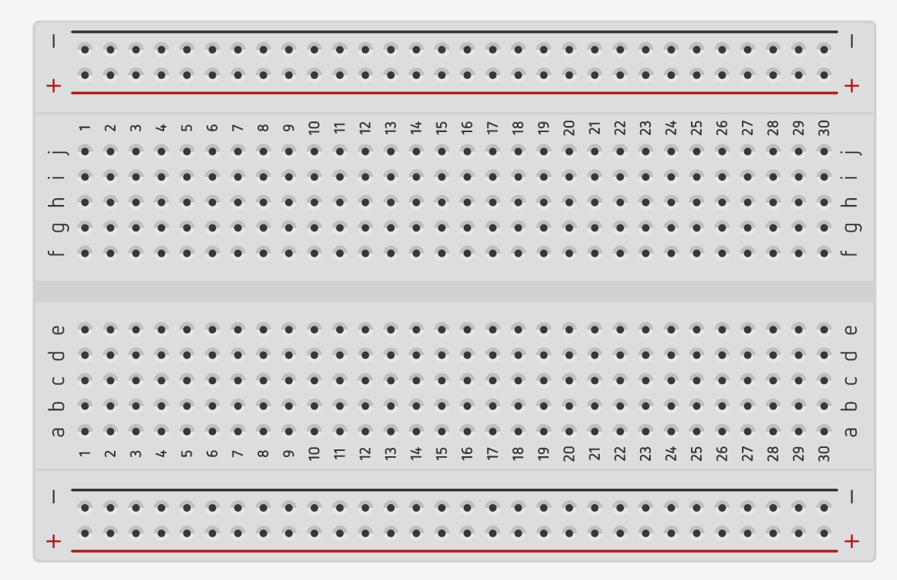
Hardware
HOW BREADBOARD WORKS

Slide 12
Hardware
RESISTORS AND OHMS LAW

Slide 13
Software
COVERING THE BASICS

Slide 14

Software
Node.js
JavaScript runtime built on Chrome's V8 JavaScript engine.
Open Source and available freely
Available at https://nodejs.org/

Slide 15

Software
NPM
Node Package Manager
Comes out of the box with NodeJs
Available at https://www.npmjs.com/

Slide 16

Software
JoHNNY-FIVE
Available through npm
Documentation at http://johnny-five.io/

Slide 17
Setting up the Arduino
GETTING SERIOUS

Slide 18
Setting Up the Arduino
Install the Standard Firmata
To enable communication with the serial port, you need the Standard Firmata Plus installated
https://github.com/firmata/arduino
All the boards today come pre-configured
Still, here is how to install it

Slide 19
Setting up the project
GETTING SERIOUS

Slide 20
Setting Up the project
NPM INIT AND DEPENDENCY INSTALL
Create a new project using npm init
Install Johnny-Five using npm install --save johnny-five

Slide 21
Setting up the project
NPM INIT
> npm init
name: (test)
version: (1.0.0)
description:
entry point: (index.js)
test command:
git repository:
keywords:
author:
license: (ISC)
About to write to /Users/jlord/Documents/Projects/test/package.json:
{
"name": "test",
"version": "1.0.0",
"description": "",
"main": "index.js",
"scripts": {
"test": "echo \"Error: no test specified\" && exit 1"
},
"author": "",
"license": "ISC"
}
Is this ok? (yes)

Slide 22
Setting up the project
NPM install
> npm install --save johnny-five
npm WARN package.json test@1.0.0 No description
npm WARN package.json test@1.0.0 No repository field.
npm WARN package.json test@1.0.0 No README data
\
> serialport@4.0.7 install /Users/jlord/Documents/Projects/test/node_modules/johnny-five/node_modules/serialport
> node-pre-gyp install --fallback-to-build
[serialport] Success: "/Users/jlord/Documents/Projects/test/node_modules/johnny-five/node_modules/serialport/build/Release/serialport.node" is installed via remote
johnny-five@0.10.6 node_modules/johnny-five
├── lodash.debounce@4.0.8
├── lodash.clonedeep@4.5.0
├── ease-component@1.0.0
├── color-convert@1.2.2
├── browser-serialport@2.1.0
├── temporal@0.5.0
├── nanotimer@0.3.10
├── firmata@0.15.0
├── chalk@1.1.3 (escape-string-regexp@1.0.5, ansi-styles@2.2.1, supports-color@2.0.0, has-ansi@2.0.0, strip-ansi@3.0.1)
├── es6-shim@0.35.2
└── serialport@4.0.7 (bindings@1.2.1, commander@2.9.0, lie@3.1.0, debug@2.6.0, nan@2.5.0, object.assign@4.0.4)

Slide 23
Hello World !
GETTING SERIOUS

Slide 24
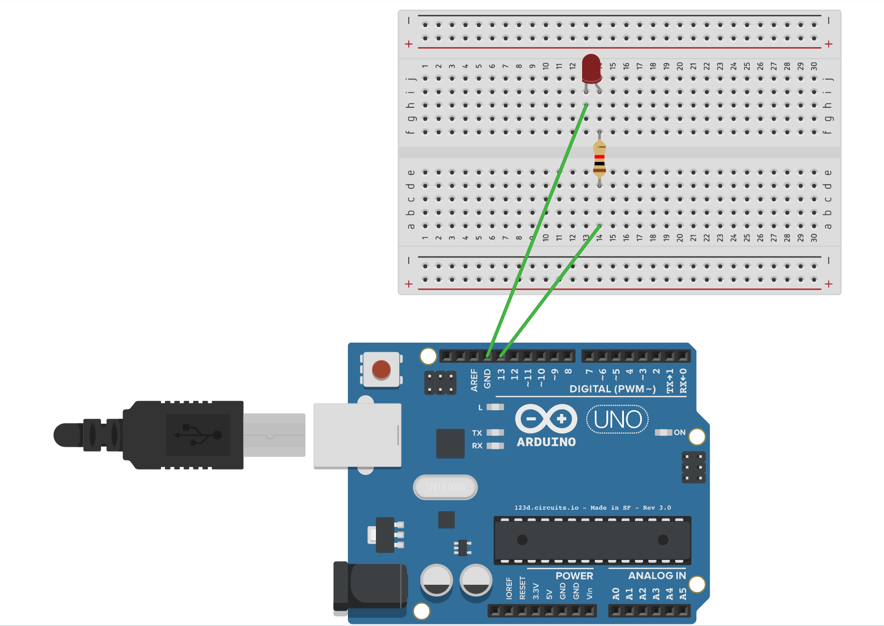
Hello World
Wiring up the lED
Wire up the LED

Slide 25
Hello World
The Code
Create the index.js file
var j5 = require("johnny-five");
var board = new j5.Board();
board.on("ready", function() {
var led = new j5.Led(13);
led.blink(500);
});

Slide 26
Hello World
The Code
Create the index.js file
var j5 = require("johnny-five");
var board = new j5.Board();
board.on("ready", function() {
var led = new j5.Led(13);
led.blink(500);
});

Slide 27
Hello World
The Code
Create the index.js file
var j5 = require("johnny-five");
var board = new j5.Board();
board.on("ready", function() {
var led = new j5.Led(13);
led.blink(500);
});

Slide 28
Hello World
The Code
Create the index.js file
var j5 = require("johnny-five");
var board = new j5.Board();
board.on("ready", function() {
var led = new j5.Led(13);
led.blink(500);
});

Slide 29
Hello World
The Code
Create the index.js file
var j5 = require("johnny-five");
var board = new j5.Board();
board.on("ready", function() {
var led = new j5.Led(13);
led.blink(500);
});

Slide 30
Hello World
The Code
Create the index.js file
var j5 = require("johnny-five");
var board = new j5.Board();
board.on("ready", function() {
var led = new j5.Led(13);
led.blink(500);
});

Slide 31
Hello World
Running the script
Run the Node script
node hello.js
1484955651472 Device(s) /dev/cu.usbmodem1421
1484955651484 Connected /dev/cu.usbmodem1421
1484955653114 Repl Initialized
>>

Slide 32
Finishing the Night light
GETTING SERIOUS

Slide 33
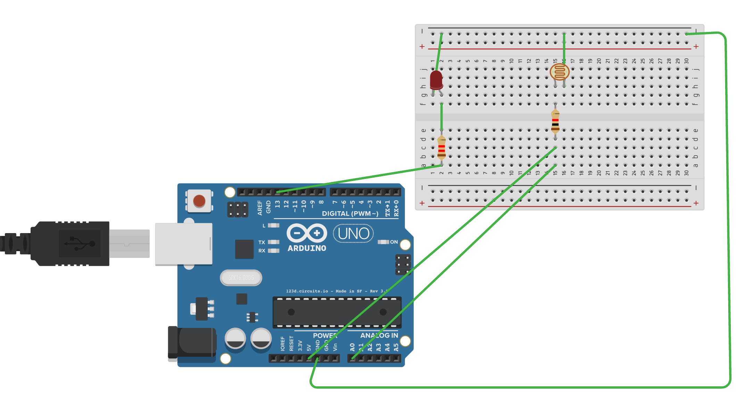
Night Light
The Code
Wire up the Photoresistor and tweak the layout

Slide 34
Night Light
The Code
Create the index.js file
var j5 = require("johnny-five");
var board = new j5.Board();
board.on("ready", function() {
var led = new j5.Led(13);
var sensor = new j5.Sensor("A0");
sensor.on("change", function() {
if (sensor.value > 750) {
led.on();
} else {
led.off();
}
});
});

Slide 35
Night Light
The Code
Create the index.js file
var j5 = require("johnny-five");
var board = new j5.Board();
board.on("ready", function() {
var led = new j5.Led(13);
var sensor = new j5.Sensor("A0");
sensor.on("change", function() {
if (sensor.value > 750) {
led.on();
} else {
led.off();
}
});
});

Slide 36
Night Light
The Code
Create the index.js file
var j5 = require("johnny-five");
var board = new j5.Board();
board.on("ready", function() {
var led = new j5.Led(13);
var sensor = new j5.Sensor("A0");
sensor.on("change", function() {
if (sensor.value > 750) {
led.on();
} else {
led.off();
}
});
});

Slide 37
Night Light
The code
Create the index.js file
var j5 = require("johnny-five");
var board = new j5.Board();
board.on("ready", function() {
var led = new j5.Led(13);
var sensor = new j5.Sensor("A0");
sensor.on("change", function() {
if (sensor.value > 750) {
led.on();
} else {
led.off();
}
});
});

Slide 38
Night Light
The code
Create the index.js file
var j5 = require("johnny-five");
var board = new j5.Board();
board.on("ready", function() {
var led = new j5.Led(13);
var sensor = new j5.Sensor("A0");
sensor.on("change", function() {
if (sensor.value > 750) {
led.on();
} else {
led.off();
}
});
});

Slide 39
Night Light
The code
Create the index.js file
var j5 = require("johnny-five");
var board = new j5.Board();
board.on("ready", function() {
var led = new j5.Led(13);
var sensor = new j5.Sensor("A0");
sensor.on("change", function() {
if (sensor.value > 750) {
led.on();
} else {
led.off();
}
});
});

Slide 40
Night Light
The code
Create the index.js file
var j5 = require("johnny-five");
var board = new j5.Board();
board.on("ready", function() {
var led = new j5.Led(13);
var sensor = new j5.Sensor("A0");
sensor.on("change", function() {
if (sensor.value > 750) {
led.on();
} else {
led.off();
}
});
});

Slide 41
Night Light
The code
Create the index.js file
var j5 = require("johnny-five");
var board = new j5.Board();
board.on("ready", function() {
var led = new j5.Led(13);
var sensor = new j5.Sensor("A0");
sensor.on("change", function() {
if (sensor.value > 750) {
led.on();
} else {
led.off();
}
});
});

Slide 42
Night Light
The code
Create the index.js file
var j5 = require("johnny-five");
var board = new j5.Board();
board.on("ready", function() {
var led = new j5.Led(13);
var sensor = new j5.Sensor("A0");
sensor.on("change", function() {
if (sensor.value > 750) {
led.on();
} else {
led.off();
}
});
});

Slide 43
Night Light
Running the script
Run the Node script
node index.js
1484955651472 Device(s) /dev/cu.usbmodem1421
1484955651484 Connected /dev/cu.usbmodem1421
1484955653114 Repl Initialized
>>

Slide 44
The End !
Questions ?
Joel Lord
January 21st, 2017
Twitter: @joel__lord
Github: http://github.com/joellord

